Slide 1
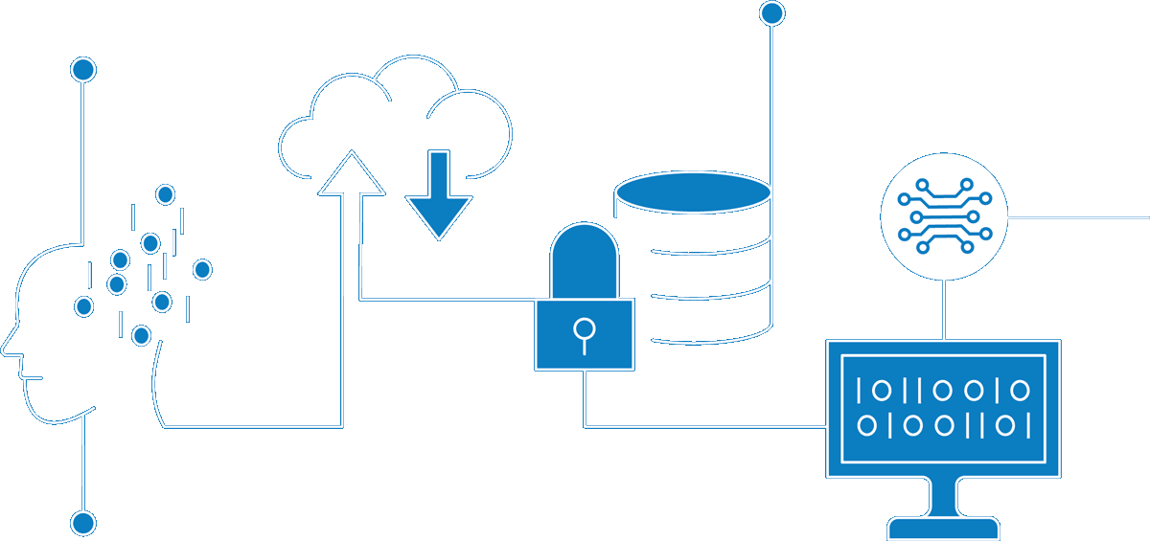
US Customer Master Data Management
Enterprise Information Architecture
Classification: Confidential
Author Nishit Ajwaliya
Date July 2021
Version v1.5
Status DRAFT

Slide 2
Contents
01 | Why Master Data Management?
 | Why Master Data Management? Business Demand for Master Data Management Data Capabilities Modernization Enterprise Data Platform
02 | What is Master Data?
 | Meta Data, Master Data, Transaction Data Example: US Customer Gas Bill
03 | What is Master Data Management?
 | Master Data Management Implementation Styles MDM High Level Architecture Benefits of Master Data Management Master Data Management Use Cases
04 | Roadmap
 | Data Capability Enablement Tools Roadmap Master Data Management Roadmap MDM Vendor/Tools US Customer Roadmap US Asset Roadmap Global Workforce Roadmap
05 | Questions
Appendix

Slide 3
01
Why Master Data Management?

Slide 4
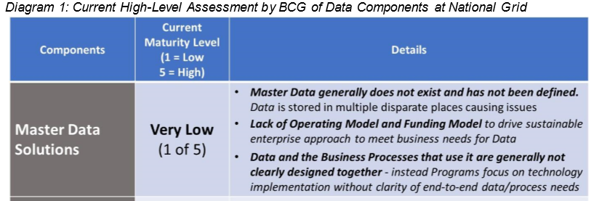
Why Master Data Management (MDM)?
As per the “Fixing Data” paper presented in April 2020 to executives by Chief Data Officer Charles Zentay at a time, unless we “Fix Data” our security, major programs, and financial and operational performance are at risk. The paper was based work by Boston Consulting Group BCG). As per the paper National Grid rates “low” or “very low” across the three major components of Data (Master Data Solutions, Data Governance, and Data Tools & Platforms). BCG’s study, that looked into a subset of the Data domains at National Grid, estimated the costs of bad Data are $73-98M. Given the limited scope of their review, they concluded that the full cost is likely much higher.”
To addresses these issues, we need three key components to “Fix Data”:
Master Data Solutions – for each data domain, establish a data master
Data Governance & Stewardship – Business ownership of data, accelerated by BMS
Data Tools & Capabilities – One, common approach to Enterprise Data solutions

Slide 5
Business Demand for the Master Data Management
US Business Domain Demand​
US Customer – MDM requirement to build high quality, consistent, accurate, and complete master customer and meter data from numerous US customer systems of record like CRIS, CIS, CRM etc. and make them available to enterprise e.g. Customer Transformation, GBE, AMI, Digital Enablement (On My Way), Energy Efficiency/Clean Energy initiative, Smart Target initiative, Consolidation of Customer Data Sources to scalable centralized repository etc.
US Asset – MDM requirement to build high quality, consistent, accurate, and complete master asset data from numerous US asset systems of record like Power Plan, GIS, Cascade, Computapole, STORMS, Maximo etc. and make them available to enterprise eg AMI, GridMod, Digital Enablement (FutureNow, VMO) etc.
UK Business Domain Demand​
UK Customer – MDM requirement to build high quality, consistent, accurate, and complete master customer data from numerous UK B2B customer systems of record CRM, SAP etc. and make them available enterprise wide eg ESO etc.
UK Asset – MDM requirement to build high quality, consistent, accurate, and complete master asset data from numerous UK asset systems of record like Ellipse, FieldReach, GeoGrid, ET Power Factory etc. and make them available to enterprise eg ESO, RIIO T2 based UK GT and UK ET initiatives etc.
Global Business Domain Demand
Workforce – MDM requirement to build high quality, consistent, accurate, and complete master workforce (Employee, Contingent worker/Contractor, and Managed Service Provider/MSP workers) data from numerous workforce systems of record like MyHub/ SuccessFactor, FieldGlass, US/UK SAP etc. and make them available to enterprise e.g. Workforce Data Domain, IAM, GBE, Digital Enablement (On My Way) etc.

Slide 6
Digital Transformation – Information Capabilities Pillars
Data Catalog & Governance
Data Quality
Master Data Management
(MDM)
BI & Self Service Analytics
Data Integration & Orchestration
Cloud Data Platform (CDP)
Data Modeling
ML/AI
Data Science
Idera ER/Studio
Informatica EDC and Axon
Informatica Cloud Data Quality (CDQ)
Matillion / MuleSoft / Striim / GoAnywhere MFT
Reltio
Snowflake
Power BI
TBD
Business transformation alignment & enablement
New technology & architecture discovery and enablement – 6 month to 5 year event horizon
Global and regional consulting support at program and project scope

Slide 7








Enterprise Data Platform
App/Service
(3rd Party)
AI/ML
Data
Science
Streaming
Analytics
Web/Portal
Consume
Ops
BI/Viz
MDM
Data Quality
Data Catalog
Integration
Service
Process
& Serve
Data Lake / Raw
(Landing)
Cached Transactional
(ODS, Ops)
Curated Foundational Layer
(DWH)
Aggregated Data Layer
(DM)
Data Architecture & Design
Ingest
Structured, semi-structured and unstructured Data
Data Ingest: Batch Pipeline, CDC, Streams, Triggers
ERP/CRM
IoT
OLTP
Mainframe
Source
APIs
Logs
Social Media
& Sentiment Data
3rd Party
SAP, Salesforce, Service Now, Maximo, other
MDM
Data Quality
Data Catalog
Data Archival
Data D/R
Data Protection

Slide 8
02
What is Master Data?

Slide 9
Meta Data, Master Data, Transaction Data
Meta Data
Data about data like structure, meaning, and relationships of data
E.g. Column CUST_ID is a Customer ID and has a size of 10 characters
Reference Data
Codes describing state and behaviour of organization entities and transactions
E.g. Status codes, Reason codes, Type codes, Classification codes, Country, State, Zip/Postal codes
Enterprise Structured Data
Hierarchies within the enterprise
E.g. Organization Hierarchy (Company, Business Unit, Division, Department etc)
Transaction Structure Data
Organization entities in which the transactions act upon
E.g. Customer, Workforce, Asset, Product, Vendor etc
Transaction Activity Data
Operational transactions typically automated in applications
E.g. Customer Billing and Payment, Work Request, Work Order, Worker Learning and Salary/Payment
Transaction Audit Data
Logs of transactions executed to bring about a process flow
E.g. transaction logs of create, update, and view of customer data
Less
More
Meta Data
Meta
Data
Reference Data
Enterprise Structure Data
Transaction Structure Data
Transaction Activity Data
Transaction Audit Data
Volume and Volatility
Semantics and impacts
Non transactional, Cross function, Business significant
Master Data Management
Master Data
Transaction Data
More
Less

Slide 10
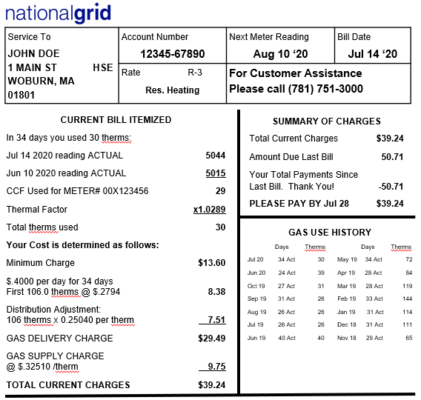
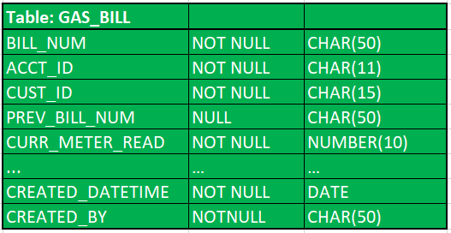
Example: US Customer Gas Bill
Gas Bill Database Table
US Customer actual Gas Bill
Gas Bill Table Data
Legend
Transaction Structure Data
Transaction Activity Data
Reference Data
Transaction Audit Data
Metadata

Slide 11
03
What is Master Data Management?

Slide 12
Master Data Management (MDM)
Master Data Management
(MDM)
Governance
Policies
Processes
Tools
Ownerships
&
Stewardships
Standards
Master Data Management is the on-going reconciliation and maintenance of Master Data
MDM is used for building reliable, accurate, non-duplicative master data that National Grid business can use for effective decision making and digital transformation
MDM is a set of policies, standards, processes, governance, stewardships, and tools that combined create a commonly trusted, consistent, accurate, and controlled set of “master data” for critical business from across internal and external data sources and applications
Core master data entities include Customer, Workforce, Asset, Location, Product, Vendor, Reference etc.

Slide 13

MDM Architecture Vision
Documented business rules in place in order to derive what information should be classed as master and have the ability to handle exceptions.
Have a defined master record for each data domain with a unique immutable identifier. Built from an aggregation of source info
03
04
DEFINED BUSINESS RULES &
CONTROLS
TRUSTED GOLDEN RECORD
Clear ownership of each data domain controlling access and changes to structure. Agreed group acting as data stewards
Have one trusted repository for all master data with pointers to relevant source system for related transactional data
02
05
OWNERSHIP &
GOVERNANCE
SINGLE MASTER DATA
SOURCE FOR
CONSUMERS
Accurate and Consumable Master Data
01
06
Aligned Enterprise, Conceptual, Logical and Physical data models.
Move away from point to point integrations and surface services through an API management layer
DEFINED DATA MODEL
PROVIDE API SERVICES
ABSTRACTING AWAY FROM
SOURCE SYSTEMS

Slide 14
MDM implementation Style
1. Registry
Build an MDM index with limited key identifier fields and the full data stays in source system
Pros:
Less intrusive as no impact to source systems
Quick and inexpensive to set up
Cons:
Complex to build 360 view if more source systems
Require most MDM configuration
Requires retrieving master data from the source systems
Possible NG use cases:
When only one or two source systems for system of record/truth
Build an MDM centralized repository with curated master data, allow data stewards to correct data in the MDM tool. Cleansed master data is not sync up with source systems
Pros:
Less intrusive as no impact to source systems
Quick and inexpensive to set up
MDM is a repository for Golden master record
Standard MDM Configuration
Cons:
Possible to have data discrepancies between source systems and the MDM tool
Requires manual updates in source systems for data quality issues
Possible NG use cases:
When multiple source systems and they are not able load cleansed data automatically
2. Consolidating

Slide 15
MDM implementation Style
3. Co-Existence
Build an MDM centralized repository with curated master data, allows Data Steward to correct data in the MDM tool, cleansed master data is synced with source systems
Pros:
Cleanse master data are in sync between MDM and source systems
Standard MDM Configuration
Cons:
More intrusive as impacts source systems
Possible NG use cases:
When multiple source systems and systems can load/take cleansed data automatically
No source system so MDM tool is the source of record
Pros:
MDM is the system of truth and source system
Cons:
Most intrusive as MDM becomes source system
Most MDM configuration
Possible NG use cases:
When there are no source systems e.g. Reference data like Postal data
4. Transaction/Centralized

Slide 16
Benefits of Master Data Management
Centralized multi domain master data repository
An enterprise unique persistent identifier for each master data domain entity
Avoid master data duplication
Increase master data accuracy
Improve master data quality
Improve master data consistency and data standardization
Provide better data compliance
Enable data governance and data stewardship
Offer better secure data access
Provide an API service for consumers of curated master data

Slide 17
Master Data Management Use Cases
Use Case | Benefit
MDM1 – Centralized data repository for multi-domain master data | All master data from multiple domains in one place, one governance and shared enterprise control process
MDM2 – System of record for unique enterprise persistent identifier for each master data entity | MDM can create a single unique identifier for each master data entity like Worker, Position, Customer, Asset, and Location etc. that is required by multiple business processes
MDM3 – Allow data quality improvements, remove data duplication, and allow data steward to see data issues and help them correcting them | Consistently maintain data quality and remove duplicate records of the Worker, Position, Customer, Asset, and Location master data entities
MDM4 – Create and maintain golden record of master data and sync cleanse and standardize data back to source systems of record | Remove data discrepancy between different source systems and have an authoritative and a reliable source of Customer, Workforce, Asset master data that solves the one biggest pain point of multiple business areas
MDM5 – Source for Master data for Common Enterprise API/Services, MuleSoft, CDP/Data Lake (Snowflake), or any other downstream systems and improve performance by reducing dependency of source systems | Consistent clean accurate master data for Common Enterprise API/Services, MuleSoft, Cloud Data Platform/Data Lake (Snowflake), or any other downstream systems

Slide 18
Master Data Management – Organization Structure (WIP)
Executive Steering Committee
Enterprise Information Architect
IT Support Team
Workforce Domain Team
Customer Domain Team
Administrative
Leadership Committee
Asset Domain Team
Business Owner
Data
Steward
Enterprise
Architecture
Solution Delivery
Data Governance
Security
Business Owner
Data
Steward
Data Governance
Solution Delivery
Enterprise
Architecture
Security
Business Owner
Data
Steward
Data Governance
Solution Delivery
Enterprise
Architecture
Security
……..

Slide 19
Master Data Management – Roles and Responsibilities (RACI)
Select the enterprise MDM tool
Stand up MDM Environment
Development & Implement
Operate & Maintain
Operate and administer the MDM platform
Tool Selection
Tool Delivery
Requirement & Planning
Appoint data stewards and other data owners
Develop & implement the full solutions
Design
Design solution for the requirement
Master Data Governance
Identify processes, roles, policies, standards, and metrics
Rules Configuration
Select Architecture and Data Model
Architecture
Document MDM Architecture and standard
Phases/Tasks
Roles
Business Owner | C | I | C | RA | I | A | C | I | A
Data Steward /SME | C | I | C | RA | I | R | A | I | C
Data Governance /SME | C | I | C | C | I | RA | CA | I | C
Enterprise Architect | RA | R | RA | C | R | A | CR | C | I
Data Solution Engineering | C | RA | C | R | RA | C | RA | RA | RA
Security | C | C | C | C | C | C | CR | C | C
RACI - Responsible, Accountable, Consulted, Informed

Slide 20
Master Data Management High Level Architecture

Slide 21
04
Roadmap

Slide 22
Data Capability Tools Roadmap (as of June 2021)
Research Initiated
Tool(s) Selected
ITGC Approved
Capability available
Expected GA
Actively Deployed
FY2021
FY2022
Q1 | Q2 | Q3 | Q4
Q1 | Q2 | Q3 | Q4
BI & Self Service Analytics – Power BI
Data Modeling - ER/Studio & Team Server
Cloud Data Platform – Snowflake
Master Data Management – Reltio
Data Quality, Data Catalog, Data Governance - Informatica
Data Integration & Orchestration – Matillion
Advanced Analytics, Machine Learning & AI - TBD

Slide 23
Master Data Management Proposed Roadmap (Draft)
Tools
2021
2022
Mar
April
May
June
Jul
Aug
Sep
Oct
Nov
Dec
Jan
Feb
Mar
April
May
Jun
Jul
Aug
Sep
Complete Security Assessment, Contact & Get Funding
MDM Tool
Select
The Tool
MDM Environment
Ready to use
Working with MDM Vendor Prof Service to plan 4 months 1st MVP with US Customer
MVP Release 1C
MVP Release 2C
MVP Release 3C
US Customer
Master Data
Approve
Implementation Funding
Customer
Pre-work
Persistent ID (leverage UDM) , Key Customer Profile and contact fields, Service Account
Customer Demographic,
Preference, Premise, Billing Account, Meter
Customer, Segments,
Customer Programs/Plans
Working with MDM Vendor Prof Service to plan 3 months 2nd MVP with Global Workforce
MVP Release 1W
MVP Release 2W
Global Workforce
Master Data
Workforce
Pre-work
Worker Persistent ID, Key worker fields, Position
Org hierarchy, Cost Center, Location, Union, Legal Entity, Vendor, Work order
Approve
Implementation Funding
MVP Release 1A
MVP Release 2A
MVP Release 3A
US Asset
Master Data
Approve
Implementation Funding
US Asset/Location Pre-work and POC
Persistent Unique ID, Key Location and Asset fields
Additional Asset and Location Fields
Additional Asset and Location Fields
MVP Release 1KA
UK Asset
Master Data
Approve
Implementation Funding
UK Asset/ Location Pre-work and POC
Persistent Unique ID, Key Location and Asset fields

Slide 24
US Customer MDM Proposed Roadmap (Draft)
2021
2022
May
Jun
Jul
Aug
Sep
Oct
Nov
Dec
Jan
Feb
Mar
Apr
May
Jun
Jul
Aug
Sep
Oct
Nov
Dec
MDM Tool
MVP
Release 1
MVP
Release 2
MVP
Release 3
MVP
Release 4
MDM tool
Ready to use
MDM/DQ/DG
Start
Customer Data model, Data Catalog, Data Governance, Data Quality Profiling, CDC, Business Rules/Requirement
Persistent ID (leverage UDM) , Key Customer Profile fields, Product, Account
Customer Contact,
Preference, Premise, Meter
Customer, Segments,
Customer Programs/Plans
Source System Integration
Approve
Funding
Sync Persistent Unique ID, Key Customer fields, Account to CRIS/CSS
Sync Contact, Preference, Product to CRIS/CSS/CRM and Premise, Meter to CRIS/CSS
Sync to Customer Segments, Customer Programs/plans CRIS/CSS
CDP (Snowflake)
Persistent ID, Key Customer Profile fields, Product, Account
Usage, Bill/Credit/Payment, Customer Contact, Preference, Premise, Meter
Customer Segments,
Customer Program/Plan, Campaign, Campaign Response
Customer Interaction,
Messages, Addition Customer Data
Other System Integration
Sync Persistent ID to CXP MyAccount
Create Customer Data API
Update Customer Data API
Update Customer Data API, Integrate with
other systems
Note:
All Timelines are subject to budget approval
Scope of each release will be finalized as per pre-work findings
Future Release timeline will be changed based on the current release date change
Each release pre-work will start ahead of the time

Slide 25

US Customer Business Capabilities Proposed Roadmap (Draft)
Delivery / Value Streams:
Data Management Foundational
Customer Data Foundational
Customer Data Integration Services
2021
2022
May
Jun
Jul
Aug
Sep
Oct
Nov
Dec
Jan
Feb
Mar
Apr
May
Jun
Jul
Aug
Sep
Oct
Nov
Dec
Releases:
MVP R1
MVP R2
MVP R3
MVP R4
Business Capabilities Support
Informatica Catalog, Governance and Quality Tools available
C7 – Product Catalog
C8 – Customer Programs
C1 – Segmentation Campaign Metrics
C3 – Personalized Messages
C13 – Consolidated Profile (Partial)
C9 – Usage Analysis
C2 – Utilization Recommendation
C4 – Customer Interactions
Reltio MDM and Matillion Tools available
C14 – Usage Prediction
C5 – Comprehensive Profile
C15 –Campaign Performance Metrics
C10 – EE Recommendations
C8 – Customer Programs
C16 – Loyalty Program
C11 – Energy Self Service
C12 – Energy Usage Insights
CRIS and CSS CDC (for MVP1)
CRIS and CSS CDC (for MVP2)
C17 – EE Ratings
C18 – Personalized Product Guidance
C20 – Usage History
C19 – Energy Savings and Incentives
C22 – Proactive Usage Feedback
C21 – Enrollment Offers
C23 – Outage Status
C25 – Customer Balance
Customer Demographic,
Preference, Premise, Billing Account, Meter
MDM/DQ/DG
Customer Data model, Data Catalog, Data Governance, Data Quality Profiling, CDC, Business Rules/Requirement
Persistent ID (leverage UDM) , Key Customer Profile and contact fields, Service Account
Customer, Segments,
Customer Programs/Plans
CDP
Data Quality Profiling, CDC, Business Rules/Requirement
Persistent ID (leverage UDM) , Key Customer Profile and contact fields, Service Account
Usage, Bill/Credit/Payment, Customer Demographic,
Preference, Premise, Billing Account, Meter
Customer Segments,
Customer Program/Plan, Campaign, Campaign Response, IVR
Customer Interaction,
Messages, Addition Customer Data
Note:
All Timelines and scopes are subject to budget approval
Future MVP timeline may change, if previous MVP release is deplayed
Each MVP pre-work will start ahead and will decide the final scope of incoming MVP based on business prioritization
Notes:
Bottom-up view of enabling Data Capabilities in support of prioritized business capabilities
- Iterative approach to building out capabilities incrementally though data enablement – Clean data available and under management - Master Data managed under MDM and both Master and Transaction Data Available within the Data Hub
Business Capabilities sequencing and timelines are still subject to Top-Down Analysis under the Program Governance & Alignment and Technology Solutioning Towers (taking place over the next 3-4 months, but subject to funding)
- Programs need to re-align priorities and release plan, cross-program gaps and dependencies need to be revisited and programs must be funded and resourced accordingly. This is especially impacted by program gaps in CRM and Automated
Marketing capabilities
- Note: CRM and Marketing Automation Completes in Dec 2022
Timelines for many of the required business capabilities extend beyond May-2022 which are being driving by process and tech changes
Some Capabilities that the Blueprint suggests will be dependent on a step change in platform can begin to be enabled by a Step change in data (e.g. Billing Insights). Other such as (New Service Connect) will obviously be clearly be dependent on AMI service

Slide 26
Global Workforce MDM Proposed Roadmap (Draft)
Delivery / Value Streams:
IAM
Workforce Data Domain
2021
2022
May
Jun
Jul
Aug
Sep
Oct
Nov
Dec
Jan
Feb
Mar
Apr
May
Jun
Jul
Aug
Sep
Oct
Nov
Dec
Releases:
MDM tool
Ready to use
(WDD Phase 1)
MVP Release 1
(WDD Phase 2)
MVP Release 2
(WDD Phase 3)
MVP Release 3
MDM Tool
Data Integration
Deep dive Integration issues
Impact analysis of ~140 workforce interfaces
Retire IAM Interim MDM Worker Persistent ID
Transition and retire IAM Interim MDM Solution
IAM tactical MDM Solution
Consolidated systems and interfaces Architecture View
Integration improvements to Downstream systems are driven from Golden Record recommendations
Enterprise Physical data model and data glossary in ER/Studio
KPIs and information ready to be consumed in a consistent approach (use of a EDP solution).
Data Linage & Data Glossary in Informatica Data Catalog tool
Implementation of data integration improvements
Implementation of data integration improvements
Implementation of data integration improvements
MDM and EDP detail
Roadmap
Alignment with Data Governance as an enabler for levels of communication
Alignment with Data Governance as an enabler for levels of communication
Alignment with Data Governance as an enabler for levels of communication
Pre-work
MDM/DQ/DG
Workforce Data Governance
Business Rules/Requirement
Data Catalog, DQ Program
Worker Persistent ID (leverage Tactical IAM MDM) , Key Worker & Position fields,
Org hierarchy, Cost Center, Location, Union, Legal Entity,
Vendor, Work order
CDP (Snowflake)
MDM Worker Persistent ID, Key worker fields, Position Data Sync
MDM Org hierarchy, Cost Center, Location, Union, Legal Entity,
Vendor, Work order Data Sync
SF Training, Competencies, Performance Measure Data Sync
Note:
All Timelines are subject to budget approval
Scope of each release will be finalized as per pre-work findings
Future Release timeline will be changed based on the current release date change
Each release pre-work will start ahead of the time
Notes:
Bottom-up view of enabling Data Capabilities in support of prioritized business capabilities
- Iterative approach to building out capabilities incrementally though data enablement – Clean data available and under management - Master Data managed under MDM and both Master and Transaction Data Available within the Data Hub
Business Capabilities sequencing and timelines are still subject to Top-Down Analysis under the Program Governance & Alignment and Technology Solutioning Towers (taking place over the next 3-4 months, but subject to funding)
- Programs need to re-align priorities and release plan, cross-program gaps and dependencies need to be revisited and programs must be funded and resourced accordingly. This is especially impacted by program gaps in CRM and Automated
Marketing capabilities
- Note: CRM and Marketing Automation Completes in Dec 2022
Timelines for many of the required business capabilities extend beyond May-2022 which are being driving by process and tech changes
Some Capabilities that the Blueprint suggests will be dependent on a step change in platform can begin to be enabled by a Step change in data (e.g. Billing Insights). Other such as (New Service Connect) will obviously be clearly be dependent on AMI service

Slide 27
Global Workforce MDM Proposed Roadmap (Draft)
Delivery / Value Streams:
IAM
Workforce Data Domain (WDD)
2021
2022
May
Jun
Jul
Aug
Sep
Oct
Nov
Dec
Jan
Feb
Mar
Apr
May
Jun
Jul
Aug
Sep
Oct
Nov
Dec
Releases:
MDM tool
Ready to use
(WDD Phase 1)
MVP Release 1
(WDD Phase 2)
MVP Release 2
(WDD Phase 3)
MVP Release 3
MDM Tool
Data Integration
IAM Tactical MDM Solution with Unique Worker Persistent ID
Deep dive Integration issues
Impact analysis of ~140 workforce interfaces
Retire/replace IAM Interim MDM Unique Worker Persistent ID Generation
Transition and retire IAM Interim MDM Solution
Implementation of data integration improvements
Consolidated systems and interfaces Architecture View
Integration improvements to Downstream systems are driven from Golden Record recommendations
Implementation of data integration improvements
Alignment with Data Governance as an enabler for levels of communication
Enterprise data model and data glossary in ER/Studio
Alignment with Data Governance as an enabler for levels of communication
KPIs and information ready to be consumed in a consistent approach (use of a EDP solution).
Data Linage & Data Glossary in Informatica Data Catalog tool
Implementation of data integration improvements
MDM and EDP detail
Roadmap
Alignment with Data Governance as an enabler for levels of communication
Pre-work
MDM/DQ/DG
Workforce Data Governance
Business Rules/Requirement
Data Catalog, DQ Program
Unique Worker Persistent ID (leverage Tactical IAM MDM) , Key Worker & Position fields,
Org hierarchy, Cost Center, Location, Union, Legal Entity,
Vendor, Work order
CDP (Snowflake)
MDM Worker Persistent ID, Key worker fields, Position Data Sync
MDM Org hierarchy, Cost Center, Location, Union, Legal Entity,
Vendor, Work order Data Sync
SF Training, Competencies, Performance Measure Data Sync
Note:
All Timelines are subject to budget approval
Scope of each release will be finalized as per pre-work findings
Future Release timeline will be changed based on the current release date change
Notes:
Bottom-up view of enabling Data Capabilities in support of prioritized business capabilities
- Iterative approach to building out capabilities incrementally though data enablement – Clean data available and under management - Master Data managed under MDM and both Master and Transaction Data Available within the Data Hub
Business Capabilities sequencing and timelines are still subject to Top-Down Analysis under the Program Governance & Alignment and Technology Solutioning Towers (taking place over the next 3-4 months, but subject to funding)
- Programs need to re-align priorities and release plan, cross-program gaps and dependencies need to be revisited and programs must be funded and resourced accordingly. This is especially impacted by program gaps in CRM and Automated
Marketing capabilities
- Note: CRM and Marketing Automation Completes in Dec 2022
Timelines for many of the required business capabilities extend beyond May-2022 which are being driving by process and tech changes
Some Capabilities that the Blueprint suggests will be dependent on a step change in platform can begin to be enabled by a Step change in data (e.g. Billing Insights). Other such as (New Service Connect) will obviously be clearly be dependent on AMI service

Slide 28
US Asset MDM Proposed Roadmap (Draft)
2021
2022
May
Jun
Jul
Aug
Sep
Oct
Nov
Dec
Jan
Feb
Mar
Apr
May
Jun
Jul
Aug
Sep
Oct
Nov
Dec
Releases:
MVP
Release 1
MVP
Release 2
MVP
Release 3
MDM Tool
MDM tool
Ready to use
Pre-work
MDM/DQ/DG
Approve
Funding
Asset Data model, Master Record, Profiling, CDC,
Business Rules/Requirement
Persistent Unique ID, Key Location and Asset fields
Additional Asset and Location Master Data
Source System Integration
Approve
Funding
Sync Persistent Unique ID, Key Location and Asset fields to Source Systems
Sync additional Location and Asset master data to Source Systems
CDP (Snowflake)
Approve
Funding
Asset and Location
Work Order, Additional Asset and Location fields
Cost and Additional Asset, Location, Work Order fields
Other System Integration
Approve
Funding
tbd
Note:
All Timelines are subject to budget approval
Scope of each release will be finalized as per pre-work findings
Future Release timeline will be changed based on the current release date change
Each release pre-work will start ahead of the time

Slide 29
UK Asset MDM Proposed Roadmap (Draft)
2022
2023
April
May
June
Jul
Aug
Sept
Oct
Nov
Dec
Jan
Feb
Mar
April
May
June
Jul
Aug
Sep
Releases:
MVP
Release 1
MVP
Release 2
MVP
Release 3
MDM UK Tool
MDM tool
Ready to use
Pre-work
MDM/DQ/DG
Asset Data model, Master Record, Profiling, CDC,
Business Rules/Requirement
MVP – Persistent Unique ID, Key Location and Asset fields
Additional Asset and Location
Master Data
Source System Integration
Approve
Funding
Sync Persistent Unique ID, Key Location and Asset fields to Source Systems
Sync additional Location and Asset master data to Source Systems
CDP (Snowflake)
Approve
Funding
Asset and Location
Work Order, Additional Asset and Location fields
Cost and Additional Asset, Location, Work Order fields
Other System Integration
Approve
Funding
tbd
tbd
Note:
All Timelines are subject to budget approval
Scope of each release will be finalized as per pre-work findings
Future Release timeline will be changed based on the current release date change
Each release pre-work will start ahead of the time

Slide 30
Master Data Management Vendors/Tools
Finalists
Informatica MDM
AWS, GCP, and Azure based single-tenant SaaS solution
Reltio
100% cloud native
AWS and GCP based multi-tenant SaaS solution (Azure support in Q2/Q3 2021)
Following 2 vendors are eliminated after first round
Riversand
100% cloud native
Azure based multi-tenant SaaS solution
WinShuttle Enterworks
No SaaS solution
PaaS solution available

Slide 31


Slide 32
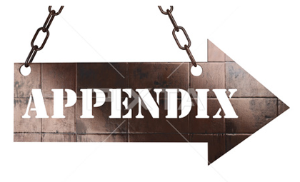

Slide 33
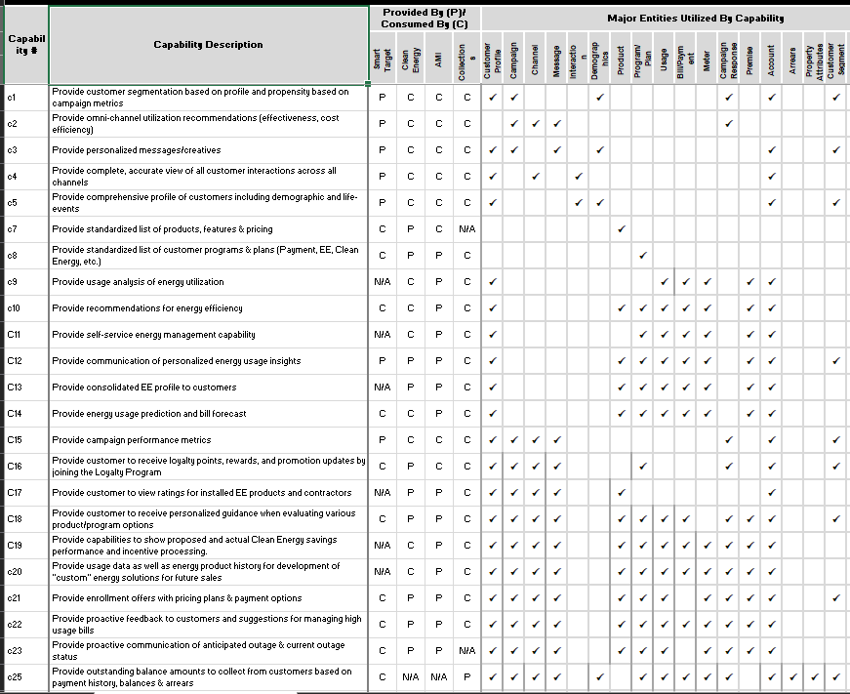
US Customer Capabilities by Programs

Slide 34
Master Data Management (MDM) Best Practices
MDM is not one and done: Master Data Management strategy should be woven into the foundation of our business. If data alignment is considered merely a one-time occurrence, we will encounter the same data mismanagement issues repeatedly.
Education is key: All personnel and departments must be trained and regularly retrained on how to format, enter, store, and access data.
Start small, but think big: When rolling out a new master data management strategy, we want to first focus on a smaller data set that may be causing some current business pain (e.g. customer or workforce or asset data for a specific geography). Done this way, you can assure buy-in for a larger rollout.
Keep our eye on ROI: Since business units have different objectives, a common ROI should be established at the outset of a master data management strategy development, and the return on investment should be examined after each phase of rollout to maintain buy-in.
Buy-in at the top: For master data management to be successful, leaders within all business units must be engaged in the development of the strategy, as well as continuously involved in ongoing governance conversations.
Don’t forget to update: Master data management strategy must include regular, synchronized updates to ensure that our single source of data has the most accurate information.

Slide 35
Master Data Management (MDM) Best Practices (continue)
Business ownership and governance: Business “users” (stewards) must take full ownership of a master data in conjunction with the IT group for technology support. Also data governance is key to success of the master data management.
Change management: Organizational change and knowledge transfer are the biggest master data challenges. A change management team, with a well thought out plan suitable for the client culture is critical. This team provides the leadership and fosters communication to resolve issues throughout the organization.
Make the Data Easy to Access: Better organization means easier access. But, improving the retrieval process doesn’t stop there. Don’t put up so many barriers between your team and the data they need. This will only slow down the entire productivity of the business, and sometimes, it can confuse employees. Keep this from happening by making access easy for all.
Improve Data Security: Both internal data and those purchased on the market must be protected to prevent information useful to the business from being compromised by a cyber-attack and security breach. Use user-specific data control to control data at the local level so that individual systems and users can receive only the data they need, only at the time they need it.

